Slide 1
3D Simulation for Thermal Management of High Performance Plug-In Hybrid Electric Vehicle
Ulises Sanchez Ruiz

Slide 2

Notes:
16 universities in the competition , Big tech schools like Gerogia tech, virginia tech, cal state LA,

Slide 3
Vehicle Architecture

Slide 4
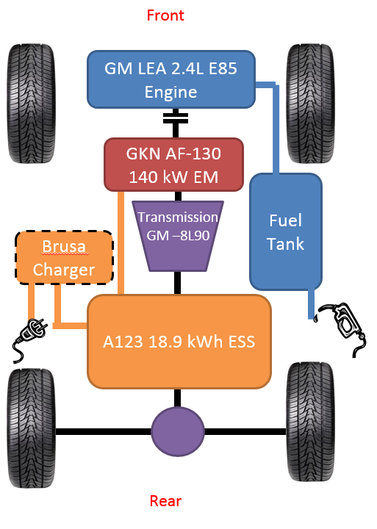
Vehicle Architecture
Parallel Pre-Transmission (P2)
Plug-In Hybrid Electric Vehicle (PHEV)
Through-shaft Design to Reduce Complexity
Notes:
Replace text with powerflow diagram

Slide 5
Unique Aspects
Through-Shaft Design to Reduce Complexity
Large Battery Pack with Limited Space
High Voltage with 18.9 kW Battery
Notes:
Cad pic

Slide 6
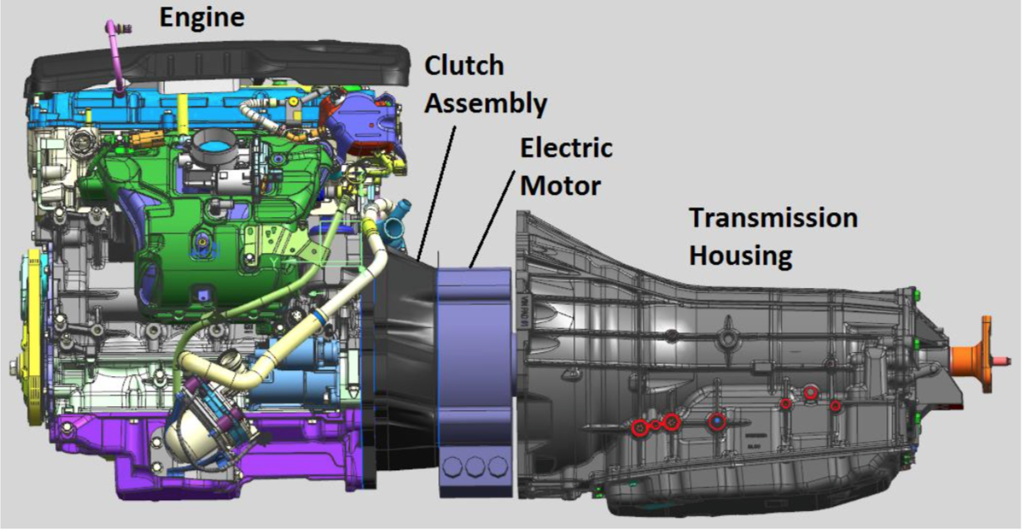
CAD
Notes:
Need to enclose for hazards.

Slide 7
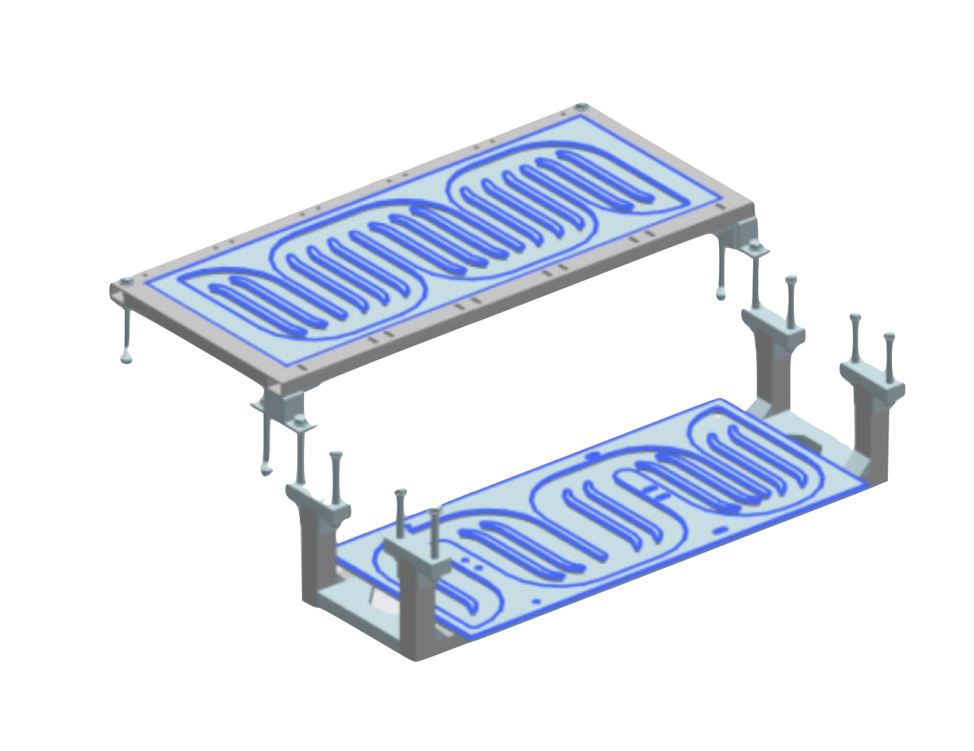
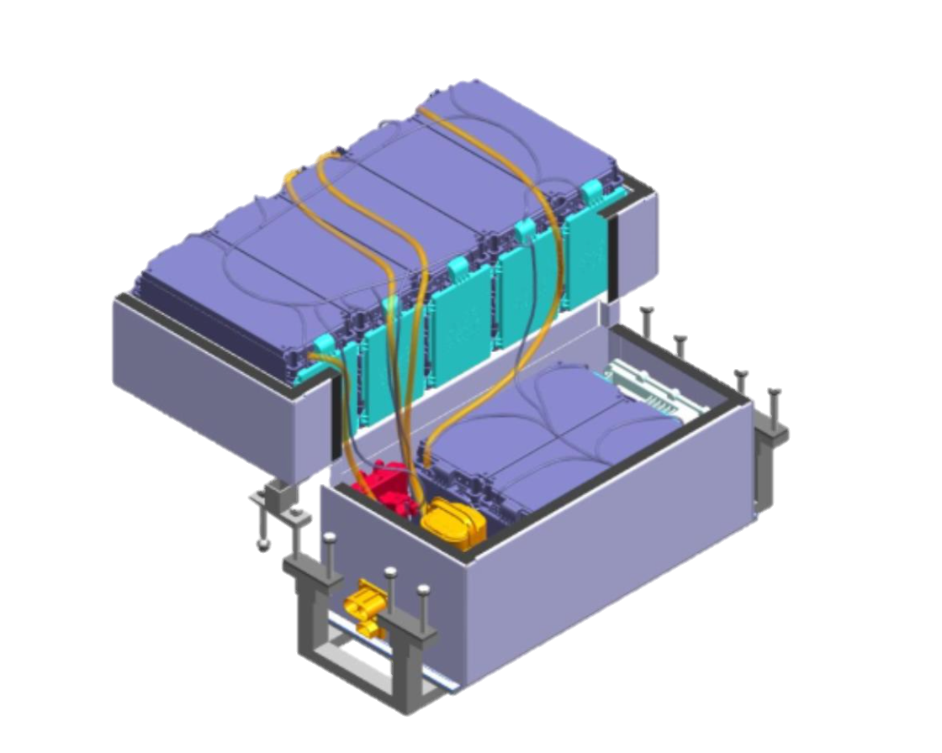
CAD
Initiating the Analysis:
CAD must first be available
A mesh is then created using NX Siemens
The mesh must not be too coarse nor too fine in order to obtain accurate results
Multiple trials required due to meshing
Notes:
Replace text with powerflow diagram

Slide 8
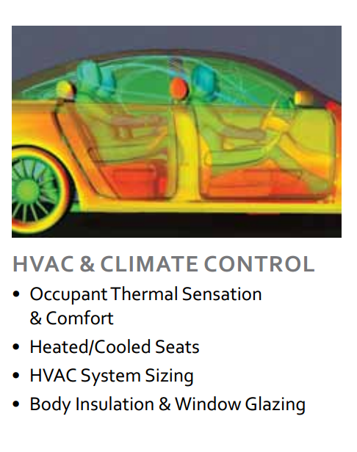
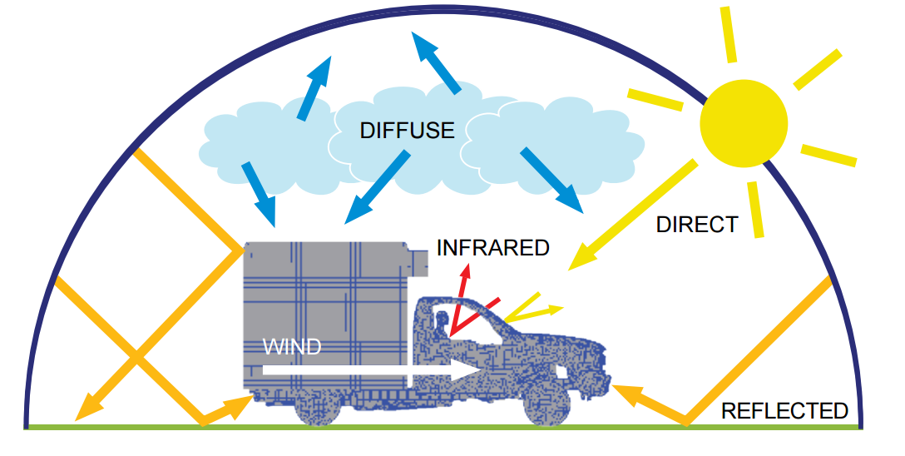
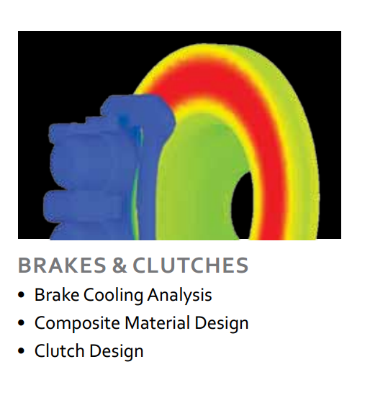
TAI Radtherm
Notes:
Radiation , conduction, convection

Slide 9
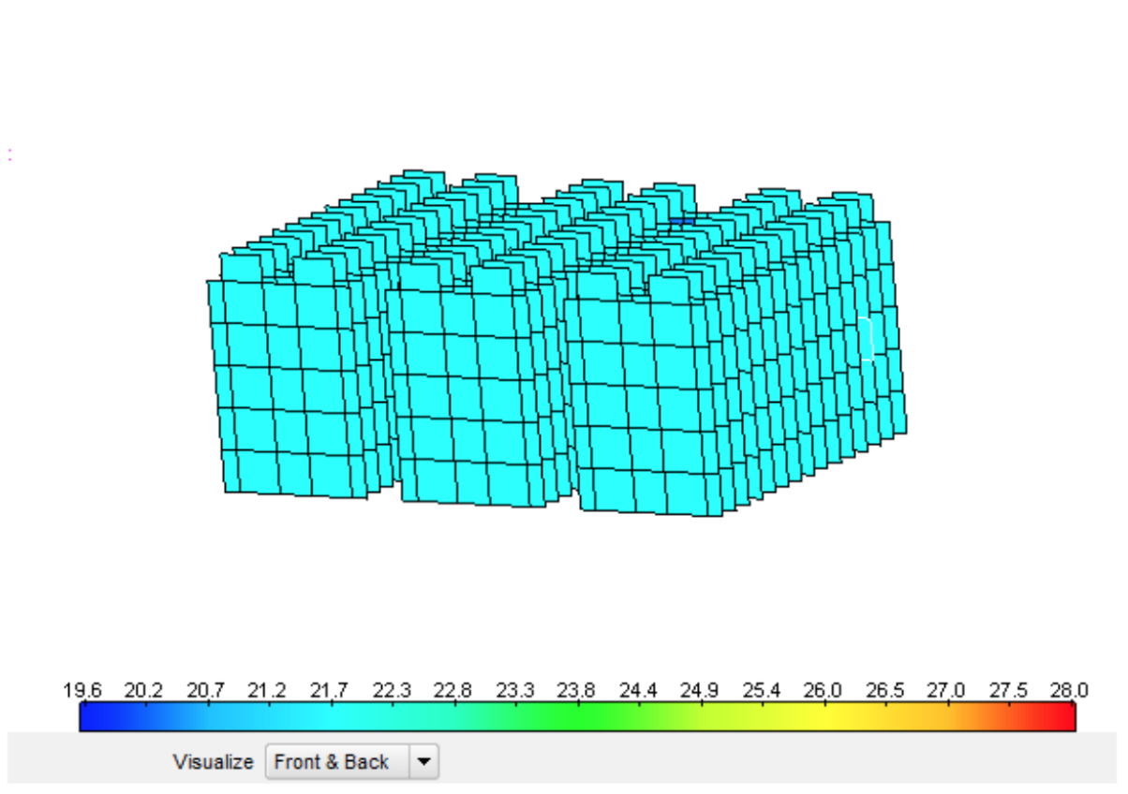
CAD
Results: Using a flow rate of 10 lpm, and assuming the maximum cooling load of 1.5 KW, uniform temperatures were obtained using TAITherm simulations.
Notes:
Replace text with powerflow diagram

Slide 10
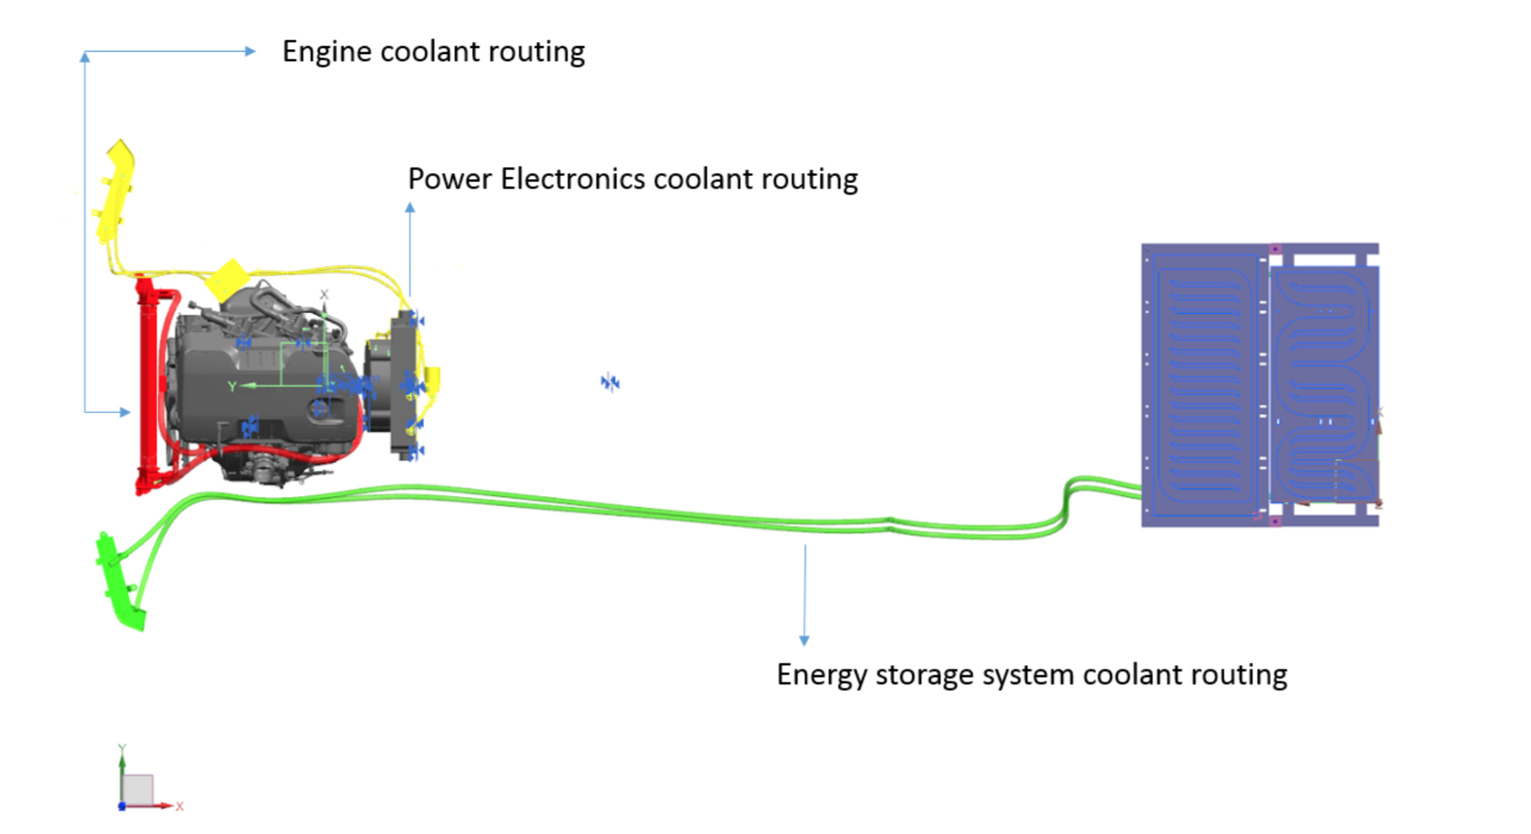
CAD
Notes:
Underside coolant routes packaging as well as high voltage lines

Slide 11
“Power is nothing without control”
-Giovanni Battista Pirelli

Slide 12


Thank You
Dr. Mayyas

Slide 13
Questions?

